Slide 1


Introduction to Software Development
Emily Crose
For
Oakland University

Slide 2
For Today
Introductions
Tools for the class
Overview of class material
Hardware & Software introduction

Slide 3
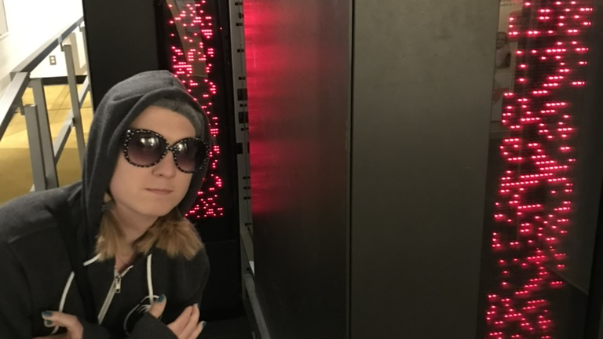
Who am I?
Emily Crose
Information security professional 13 years
Frequent public speaker
Formerly US Intelligence Community
Current research manager @ Sophos

Slide 4
Contact info
ecrose@oakland.edu

Slide 5
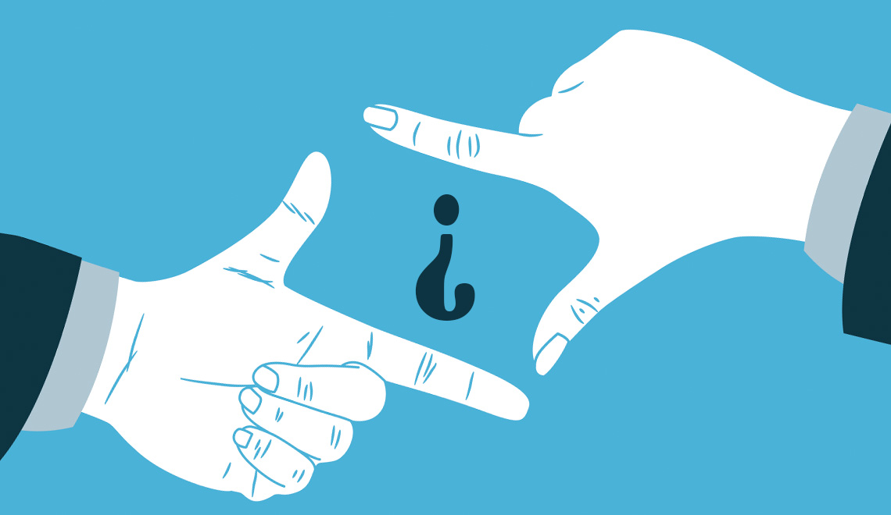
What about you?
Notes:
What about you all? Where do you come from? What kinds of backgrounds do you have? Show of hands, who has worked with programming before? Has anyone written a program or maintained one before? I understand that many of you are coming from a fairly diverse background, so does anyone want to volunteer to tell me some about their background? It would help me to calibrate how and what I focus on in the course.

Slide 6

When we meet
Meet 4 times/week
3 hours/day
4 weeks
Mondays, Tuesdays, Wednesdays & Thursdays
7AM Eastern – 10AM Eastern
Notes:
We will be meeting 3 times a week on Tuesdays, Wednesdays and Thursdays for the next 5 weeks. We’ll begin around 7AM and end around 10AM Eastern time.
I will make class materials available in two places: Moodle, and Github. Github is one of the tools that we’ll be talking about in this class, so if you want to challenge yourself to put some of what we talk to into practice, jump over to github where the class materials will also be made available.

Slide 7
Tools we will use
Moodle
Class materials
Github
Code repositories
Change management
Jira
ticketing
Confluence
For wikis
More?

Slide 8

Course overview
What will we be talking about in this course?
What do you want to learn?
Notes:
In this class, we’re going to talk about the process of modern software development.

Slide 9
Material overview
Understanding modern software
How it works
How it is maintained
The Software Development Life Cycle (SDLC)
Tools for managing software development
Management techniques for maintaining codebases
Standards that apply to these topics
Notes:
In this class, we’re going to talk about modern technology. How it works, and how we maintain it. We’ll talk about some of the most popular tools you’ll use in this work. You will also have opportunities to be exposed to these tools in this class through presentations, but also though hands-on use for some of these tools if you choose to do so.
We’re going to talk about the Software Development Life Cycle (Also called the SDLC) and how this general principal applies to developing and maintaining codebases. Alongside that topic, we will talk about some management techniques which can be used to help apply the principals from the SDLC to your everyday work.
Finally, we will talk about some of the standards which apply to these topics, and a few that will apply directly to your work.

Slide 10


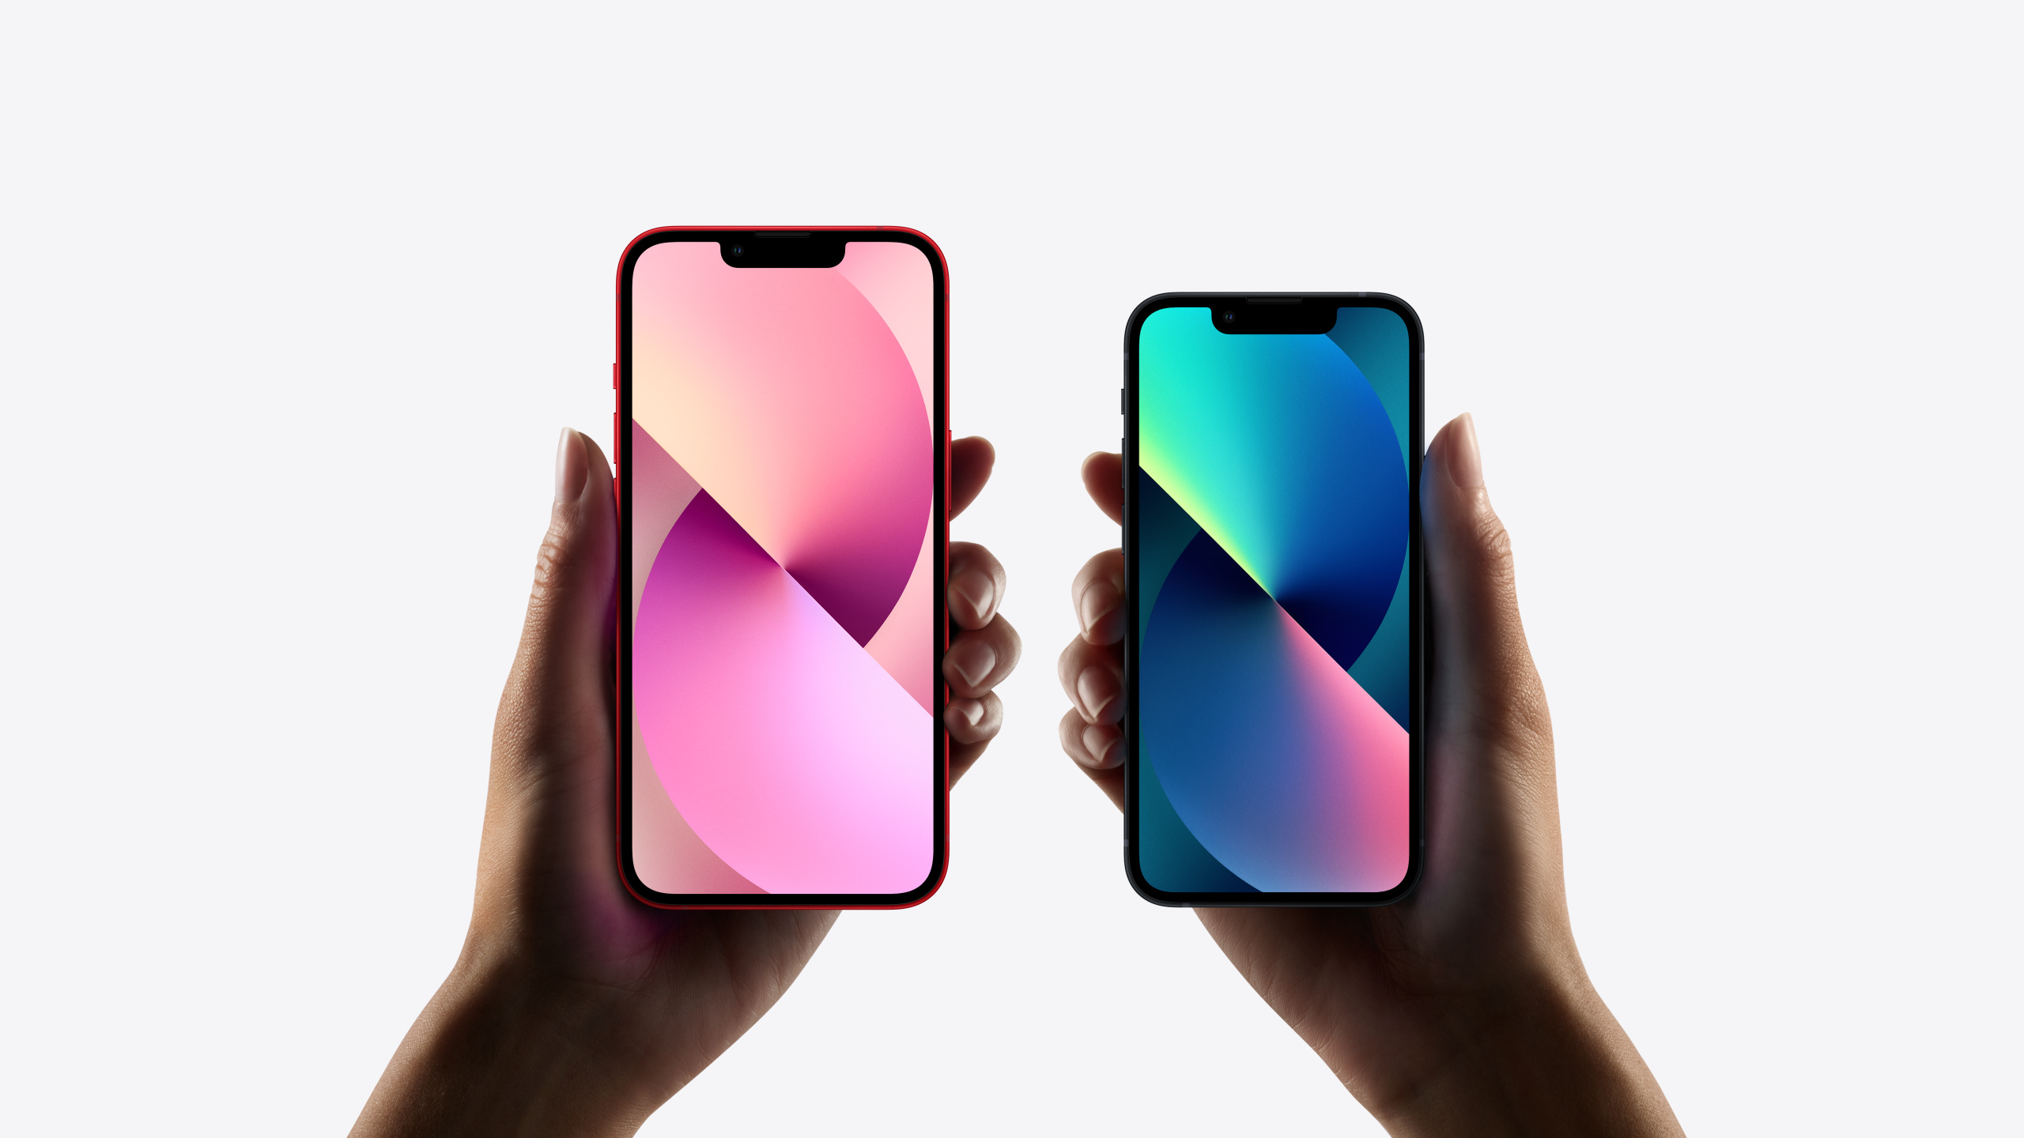

Software we can see
Notes:
To start our conversation about how to build software, let’s think about some of the software we deal with on a daily basis. In this slide, we can see some examples of software we can see and touch. Most of you are probably using browsers like Firefox, Chrome, Internet Explorer and Safari to get access to these course materials. Many of you also probably have a smart phone which entirely runs on different variations of software. One application we will all certainly be using in this class is Moodle.

Slide 11

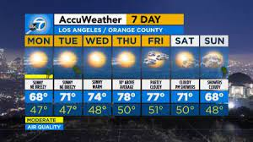
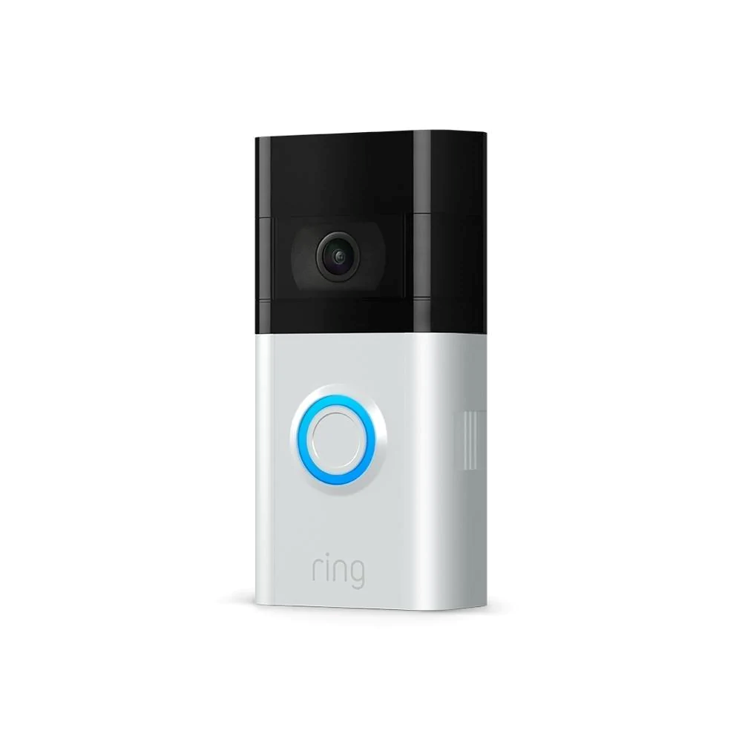
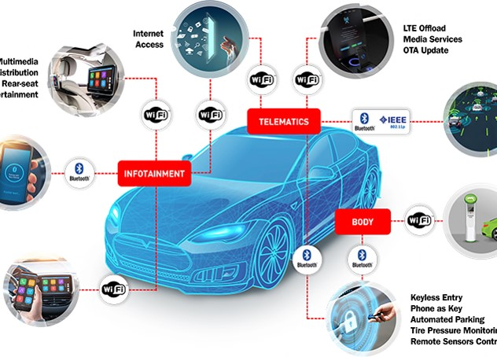
Hidden software
Notes:
But not all software works in a way that we can see and understand as obviously as some of the software we saw in the previous slide. When you double click on a browser application on your computer, you probably understand that what you’re doing is starting a piece of software. But software is actually all around us all the time. When you turn on your TV or radio (which typically only operate thanks to software…unless you’re using a crystal radio or something.) You might hear a weather report. That weather report is created using information compiled from computerized models and programmed algorithms.
If you’ve put any smart home devices into your house like smart lights or a ring doorbell, those run a lot more different types of software than the average person probably knows. Any car built in the last 10 years also comes with an incredible amount of software under the hood.

Slide 12
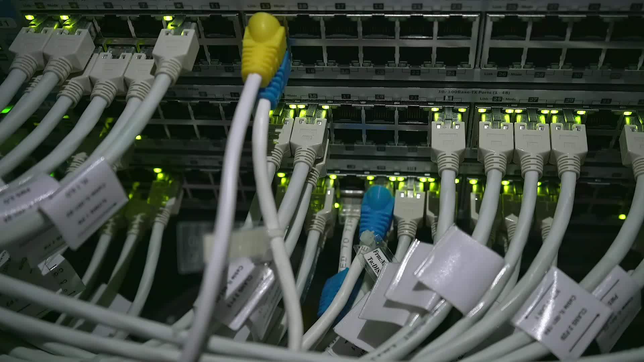
Hardware vs software
Notes:
If you’re even incidentally aware of software, then you’ve probably also heard the term “hardware” before. Hardware and software are interrelated.

Slide 13

Hardware Components
Central Processing Unit (CPU)
Graphics Processing Unit (GPU)
Random Access Memory (RAM)
I/O devices
Keyboard
Mouse
VR Headset

Slide 14

Hardware Components Cont’
Sensors
Temperature
Pressure
gyroscope

Slide 15
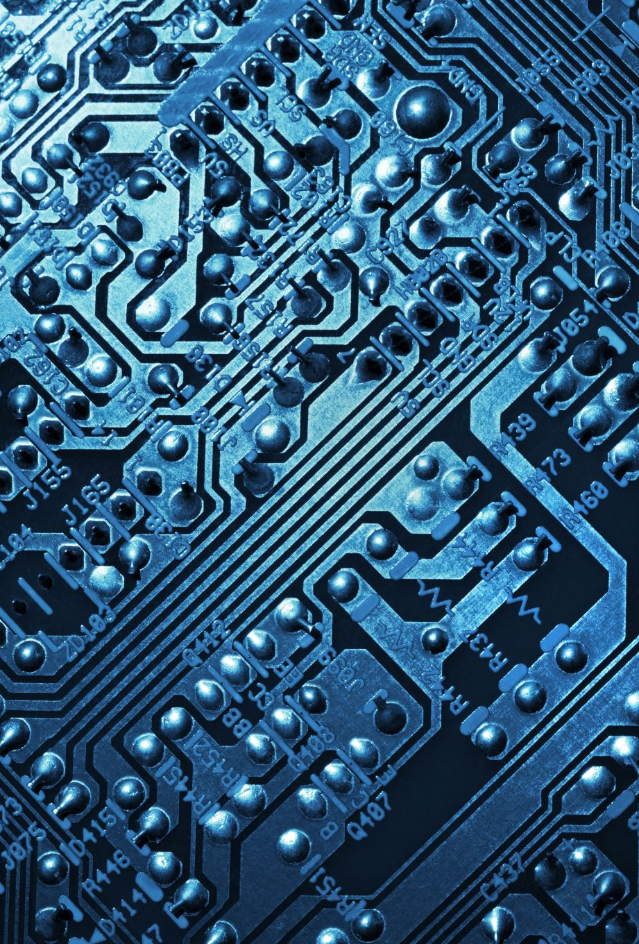
Purpose of hardware
The physical half of computing (As opposed to logical)
Does physical calculations
Produces signals which are interpreted by software

Slide 16

Purpose of software
Provides interface between hardware and the user
Software provides a “logical” layer of interpretation

Slide 17
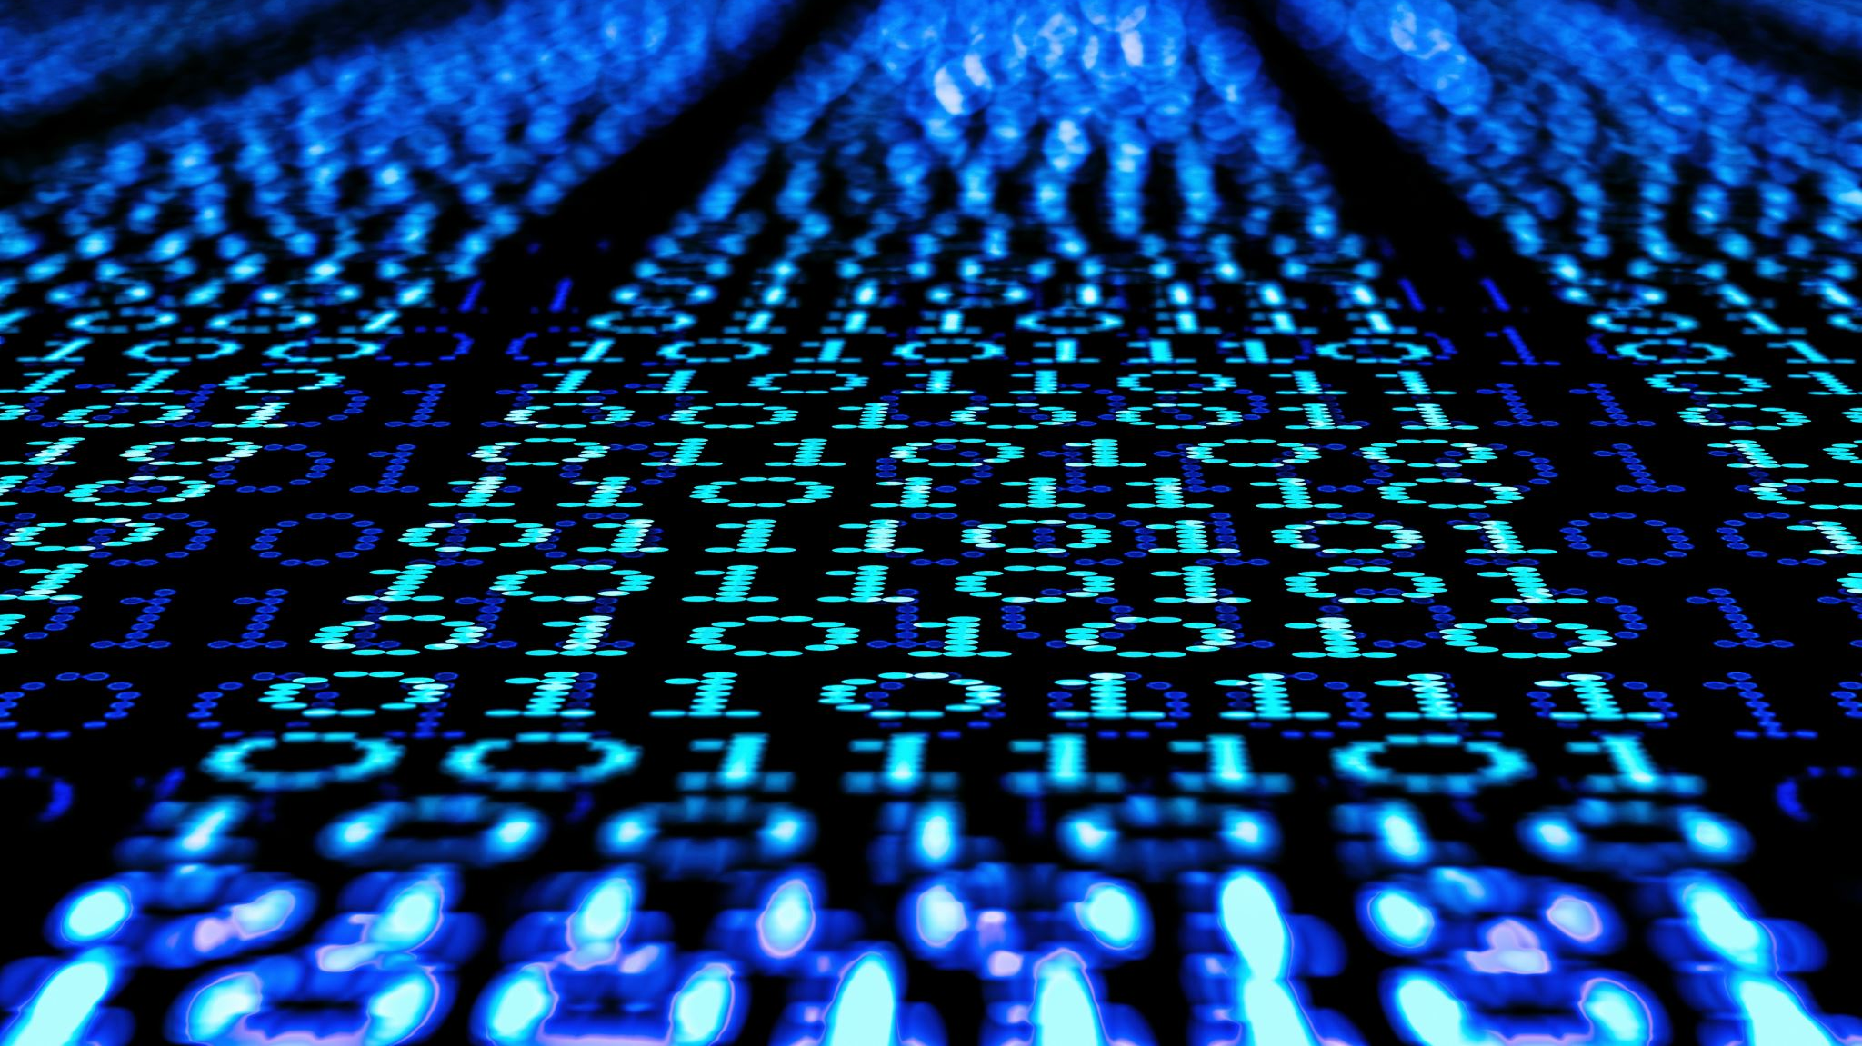
Modern software
Notes:
Modern software operation is a combination of some old things and some new things.

Slide 18

Old things
Old languages
Javascript
C
C++
Assembly
Desktop software
Mainframes?

Slide 19
Operating systems
Windows
10
11
Embedded
Mac OS
iOS
Linux
Various flavors

Slide 20
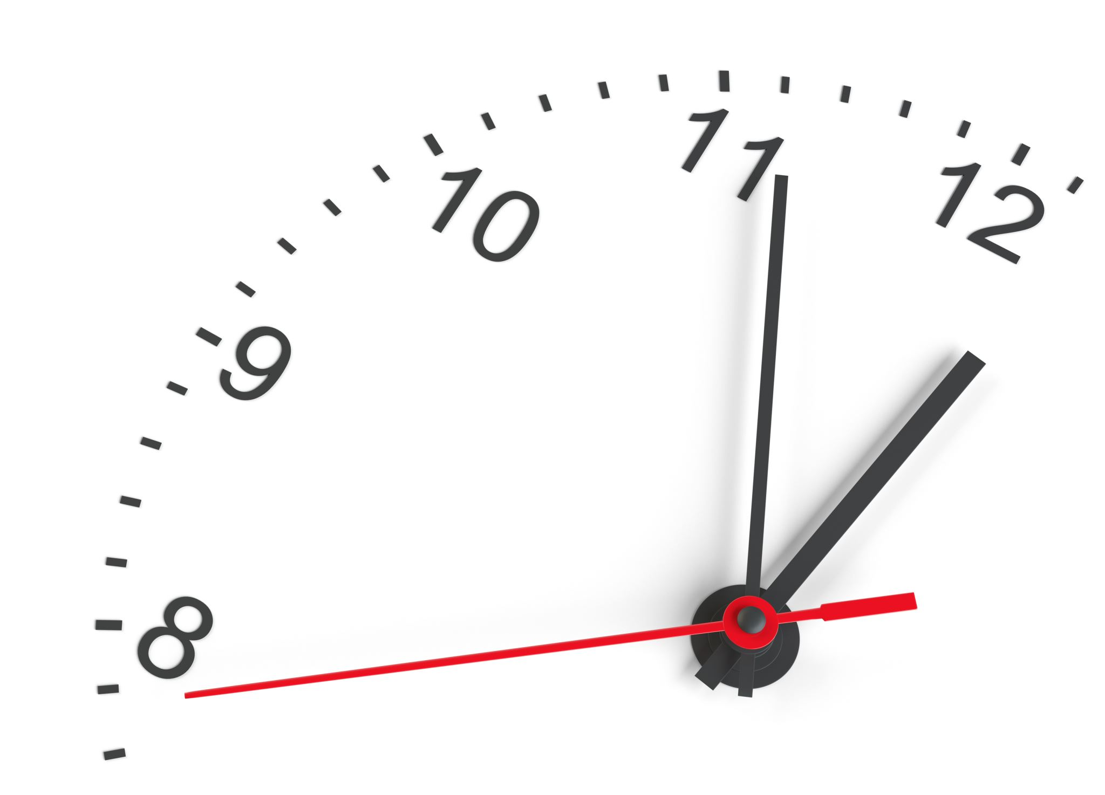
10 minute break!

Slide 21
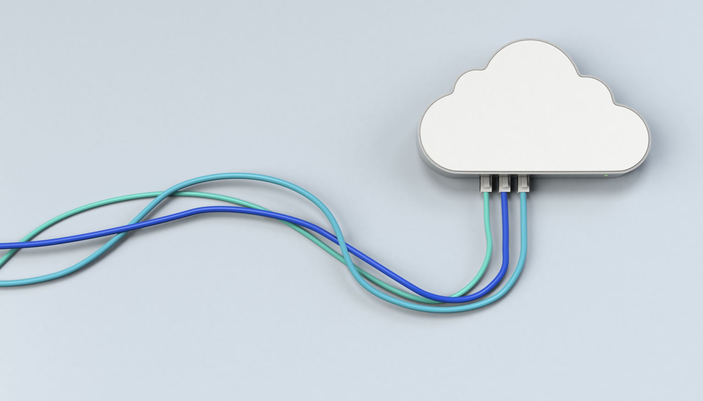
New things
Mobile & IoT
“THE CLOUD”
AI programming assistance

Slide 22

What is the cloud?
Have we seen this before?

Slide 23
Popular cloud vendors
Azure (Microsoft)
Amazon Web Services (AWS)
Google cloud computing
Resellers

Slide 24
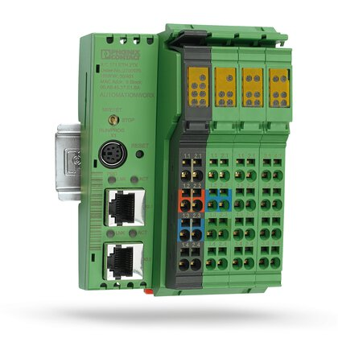
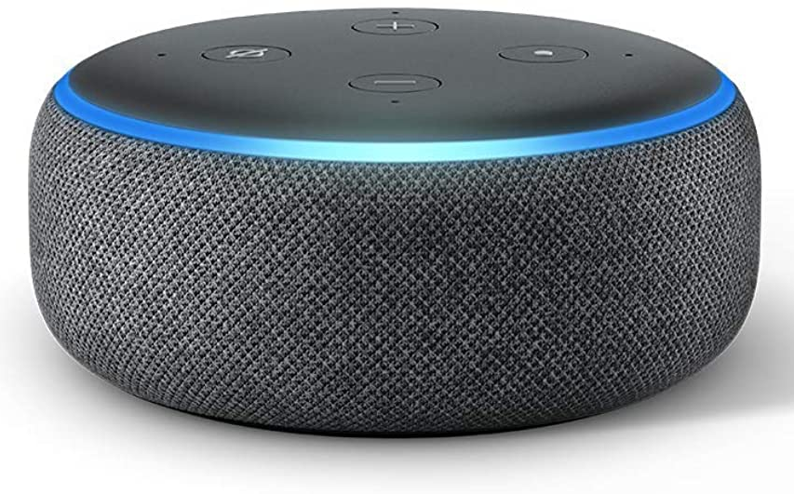
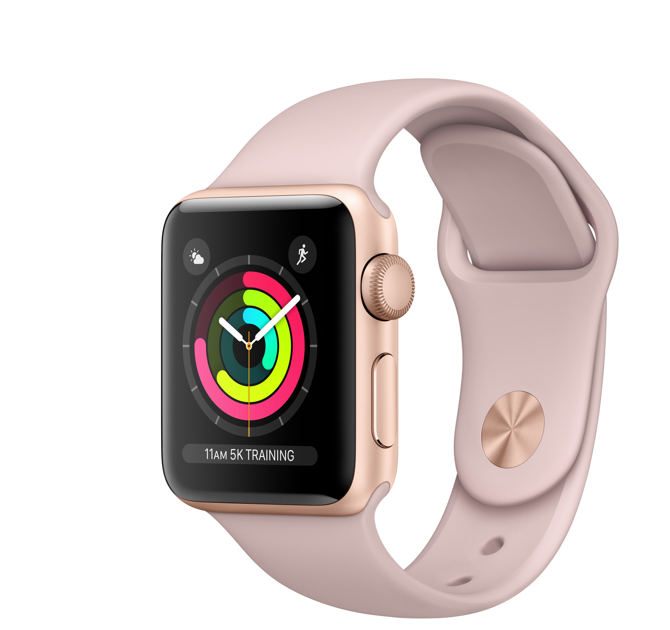
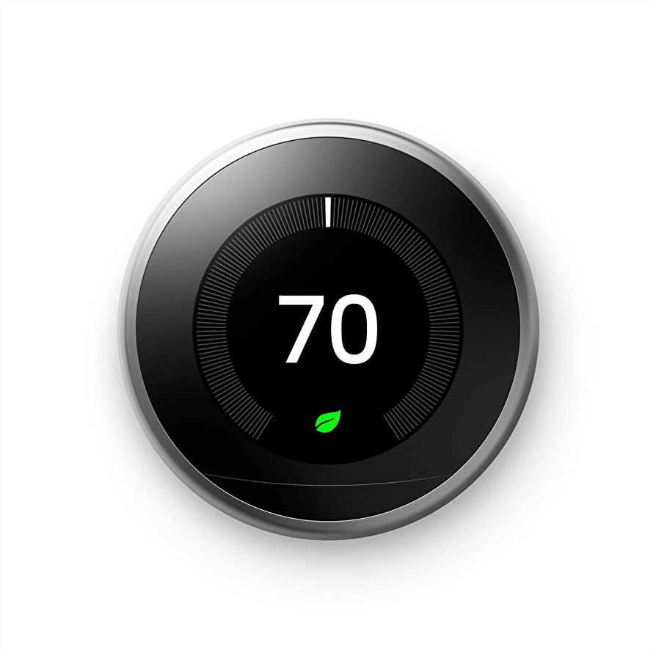
What is mobile/iot?

Slide 25
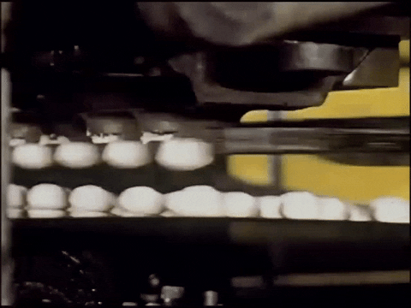
Factory tech
hardware + software!

Slide 26
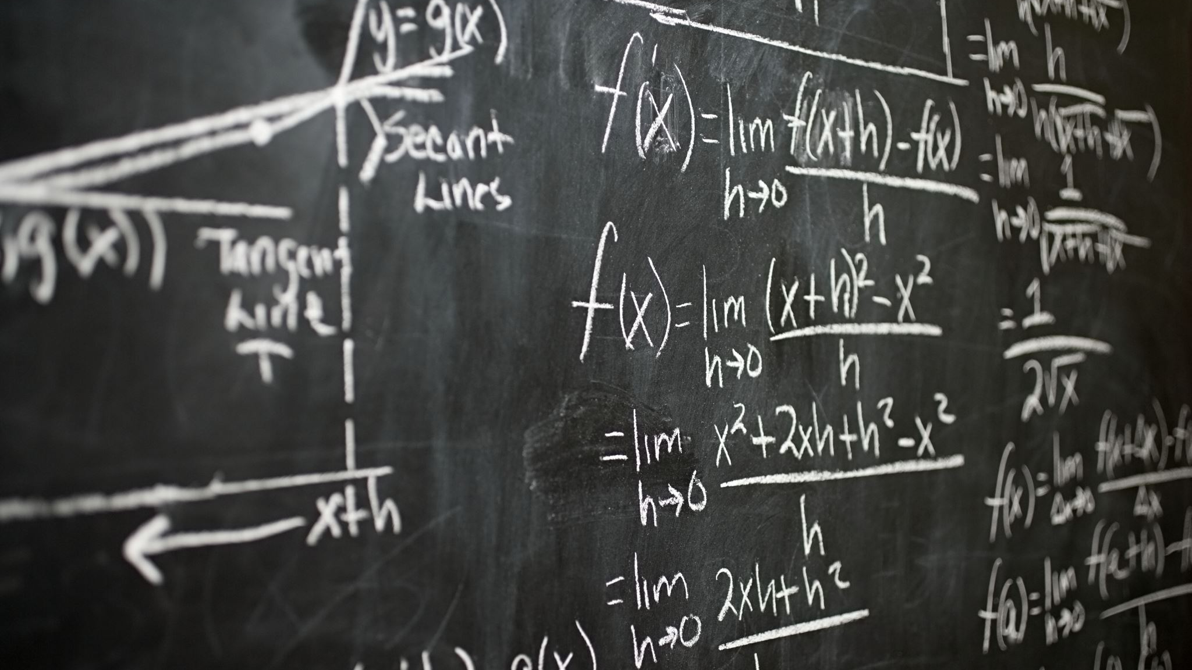
Important terminology

Slide 27
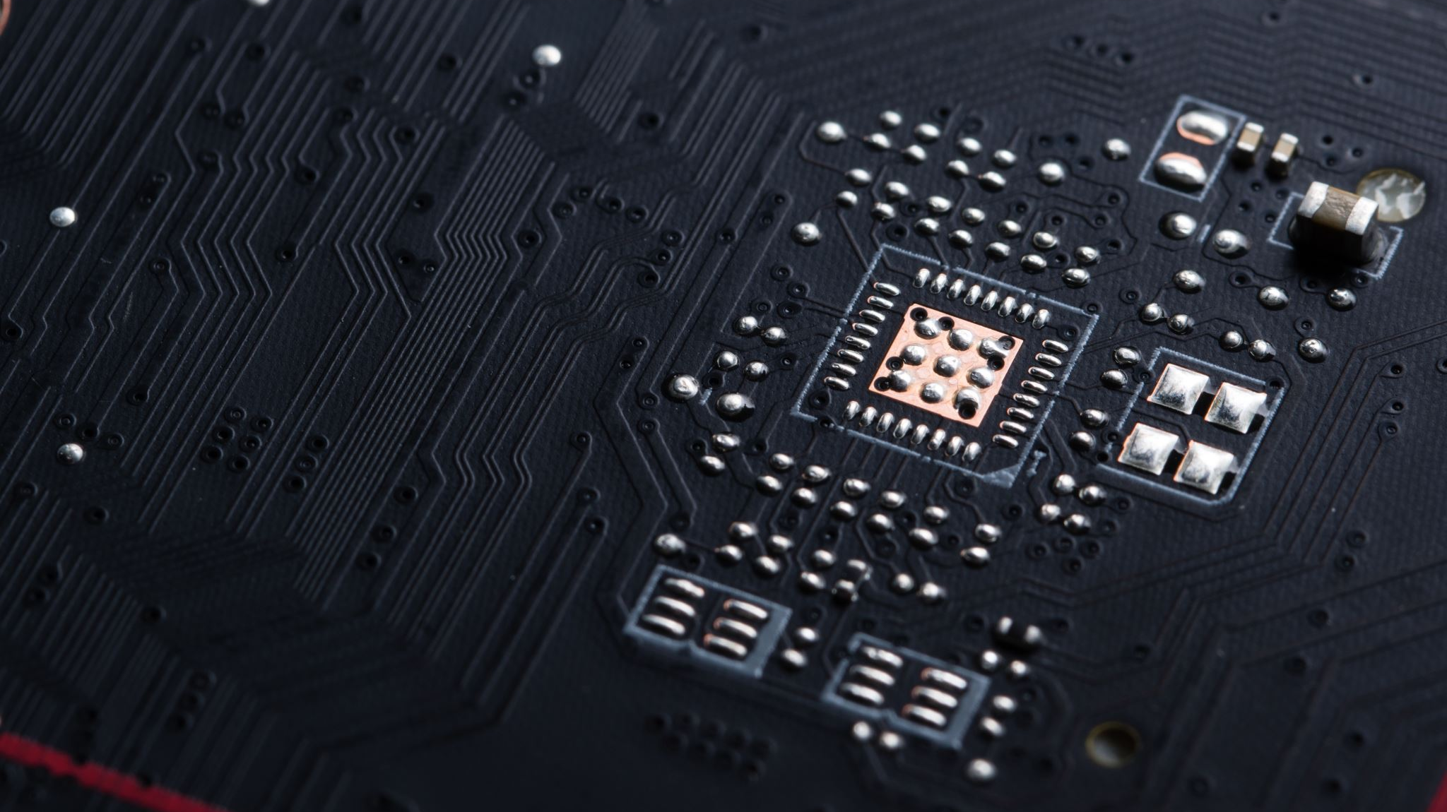
Hardware terminology
CPU/processor
Architecture
Server
Infrastructure

Slide 28
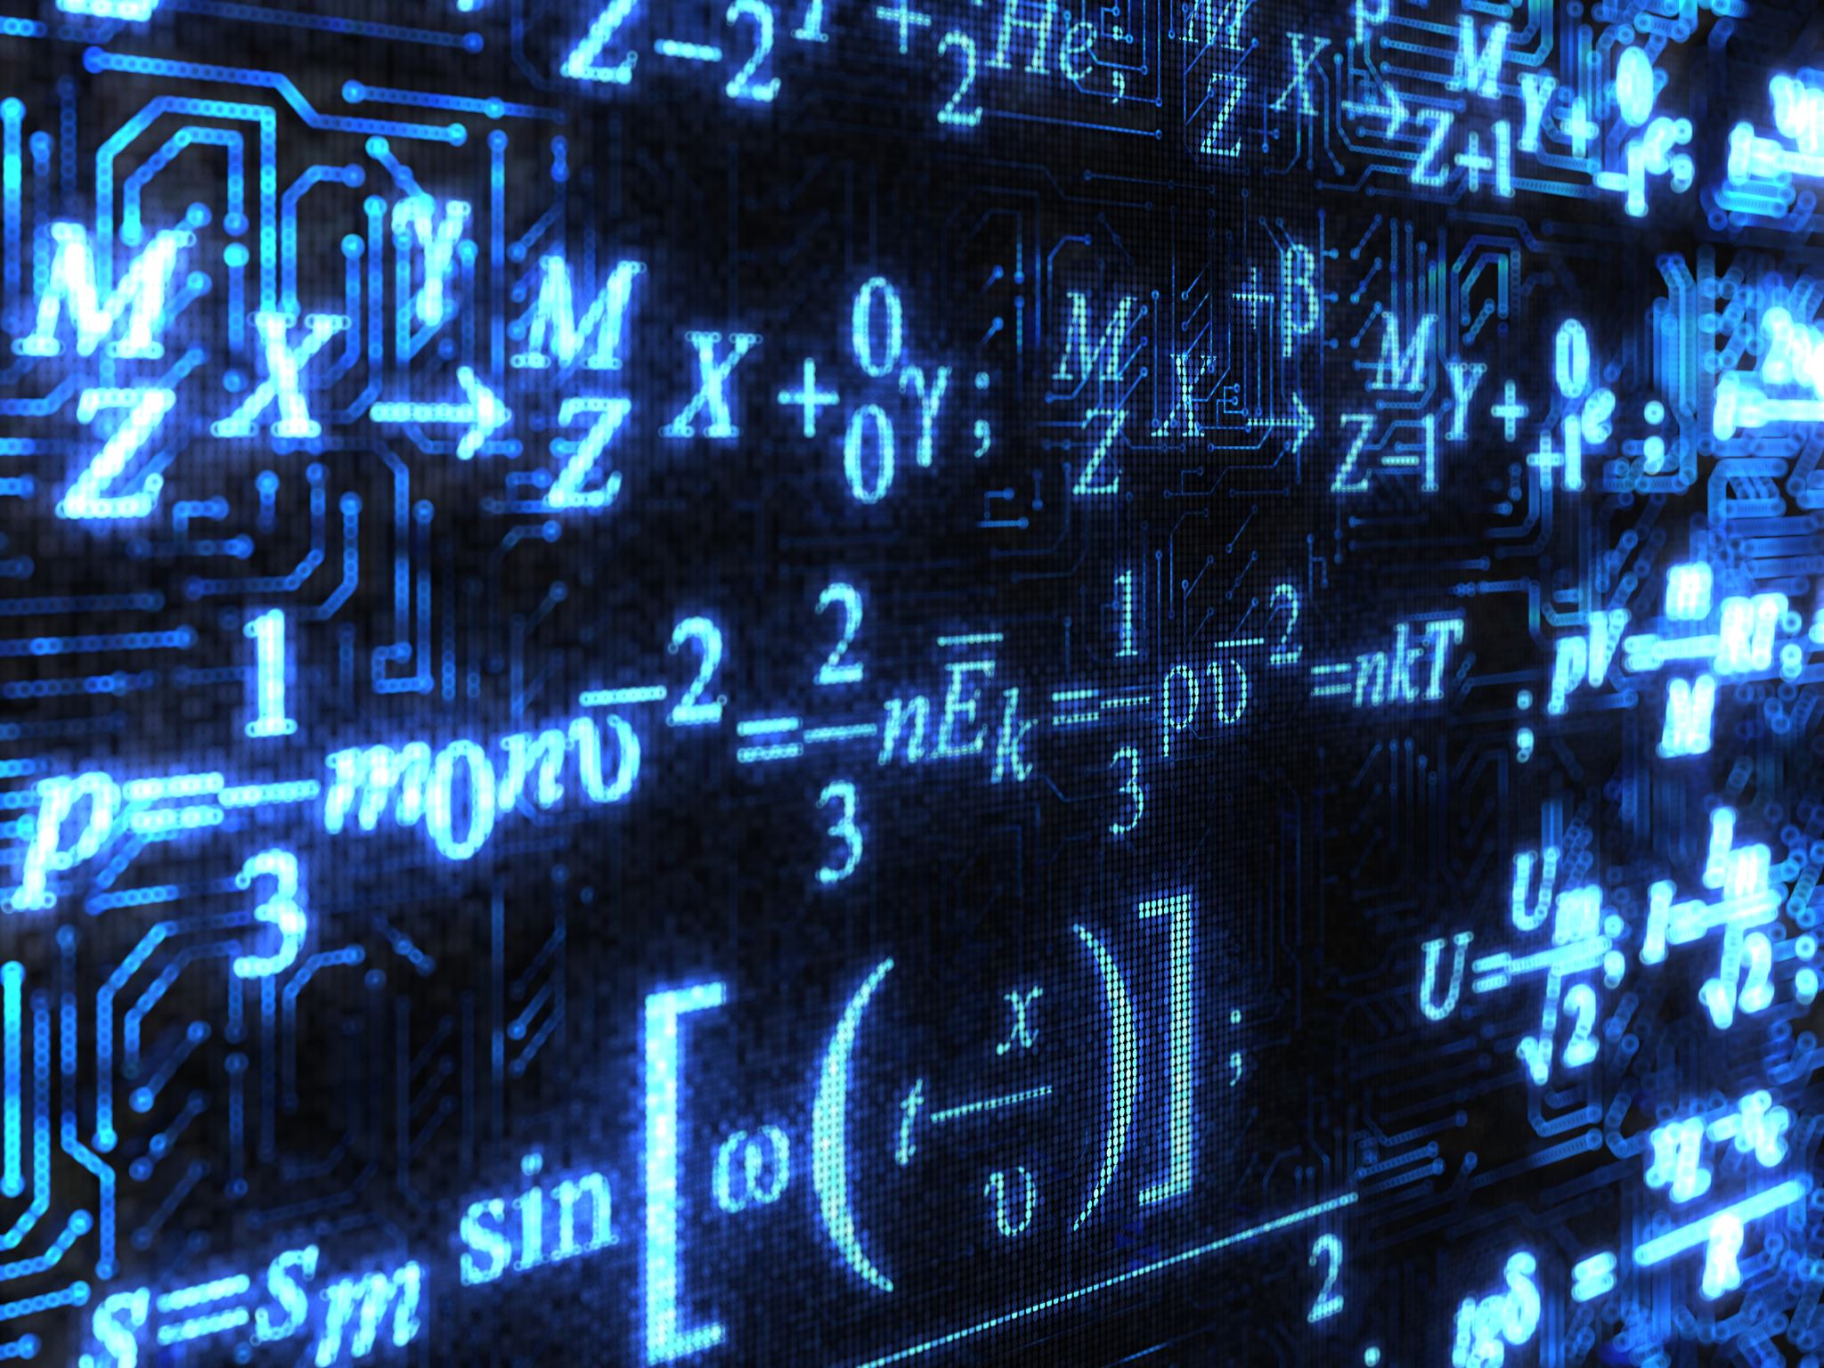
Software terminology
Programming/coding
Updates vs. Upgrades
Code commenting
Parsing
Execution
Environment
Application Programming Interface (API)

Slide 29
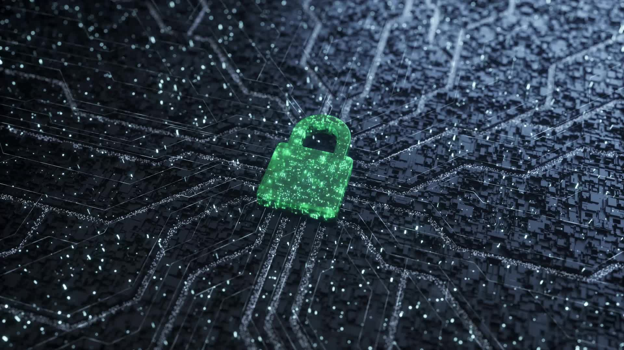
Security terminology
Vulnerability
Exploit
Payload

Slide 30

What is a program really?
Notes:
Yesterday, we talked at a high level about what a program is, but we kind of talked about it as if everyone knows exactly what a program is. So let’s ask an obvious question; what is a program really?

Slide 31

Program == code

Slide 32
Code == instructions

Slide 33
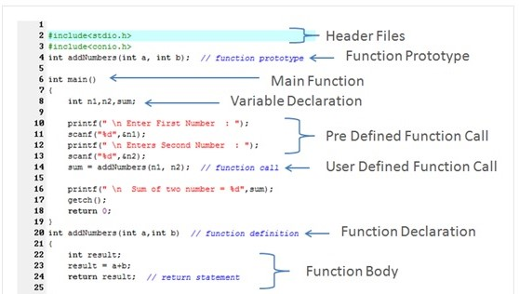
Parts of a program

Slide 34
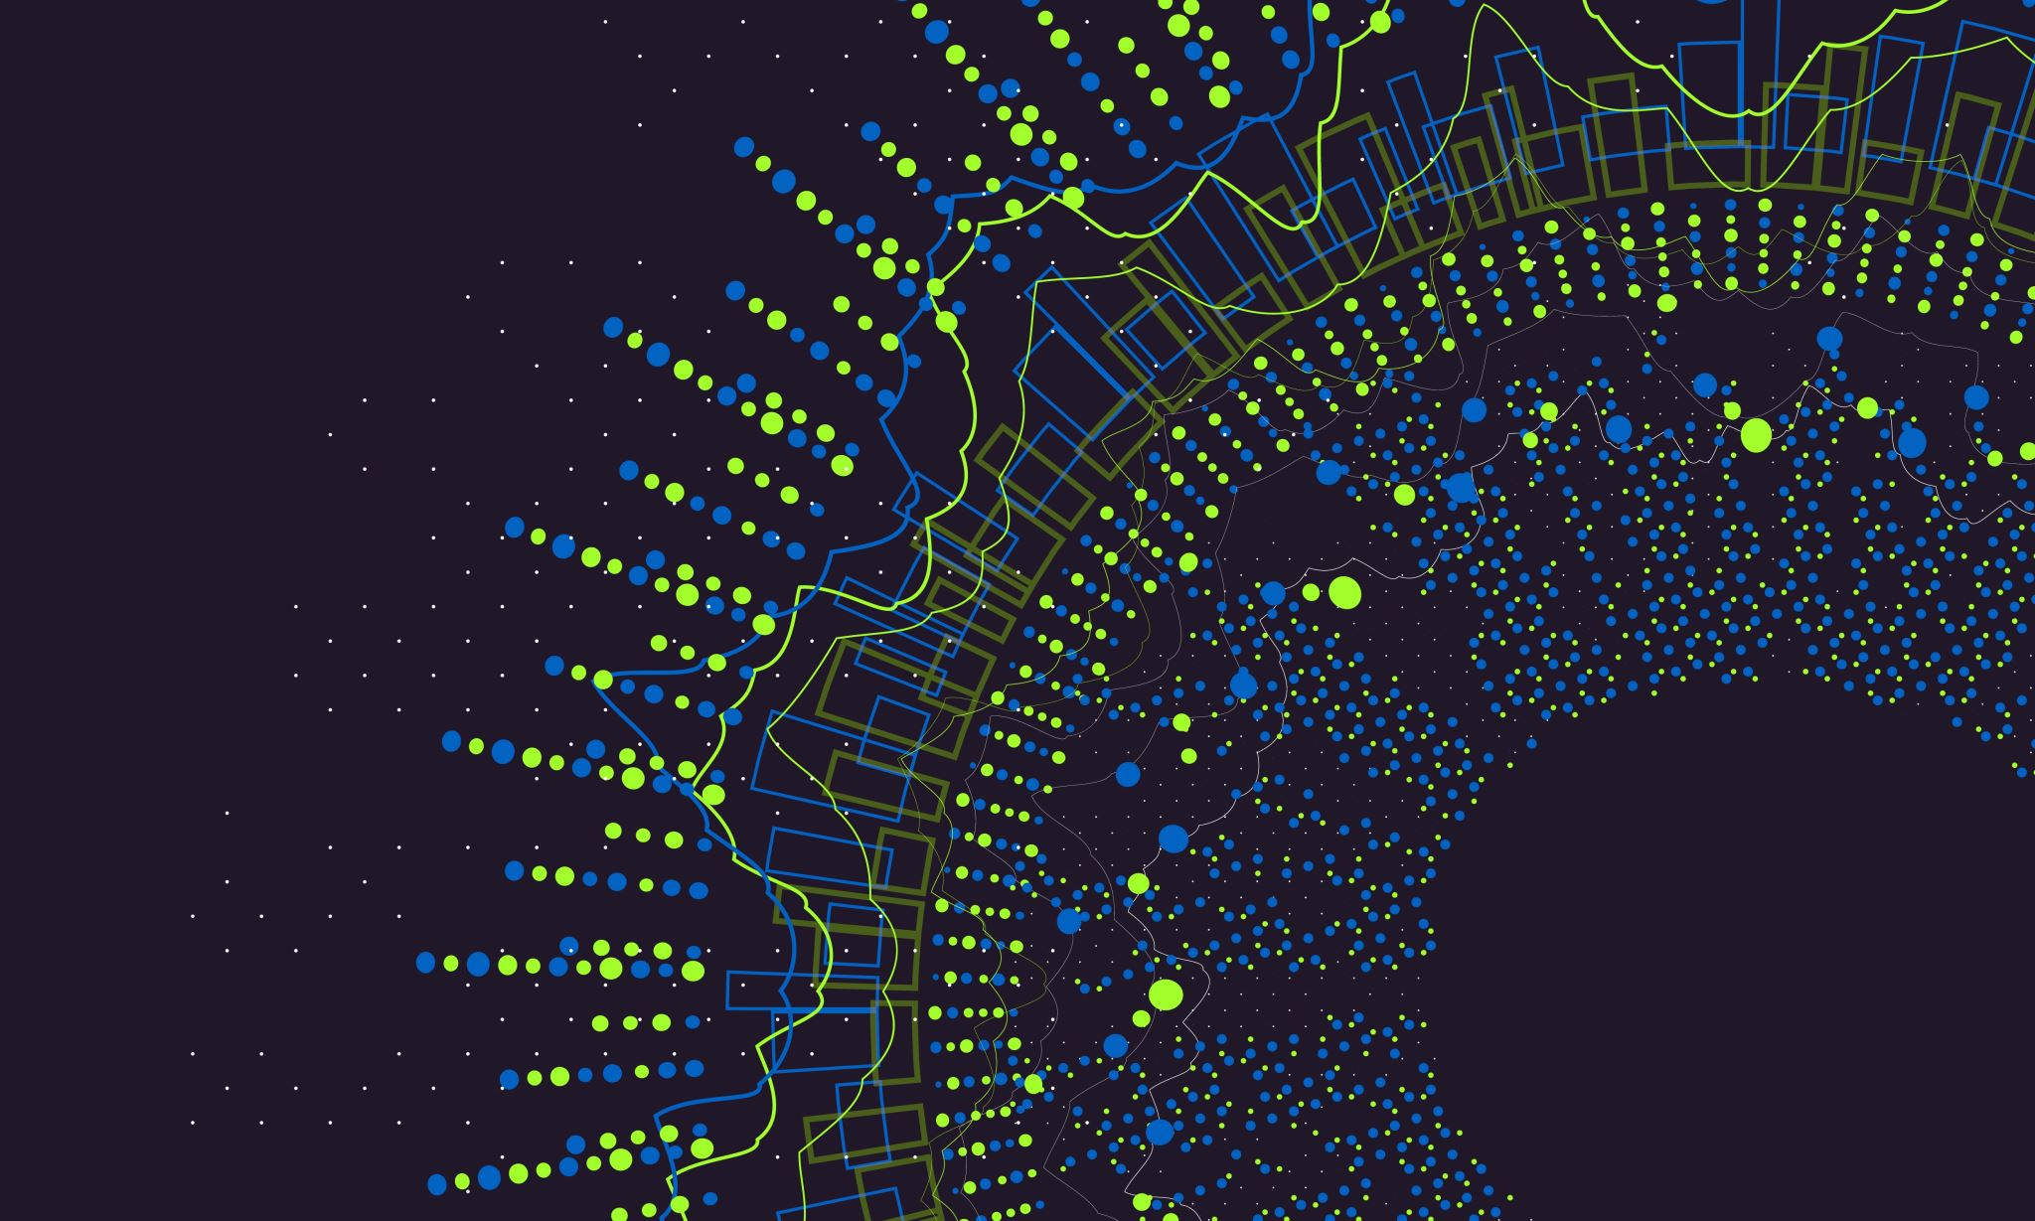
Scripts vs. binaries
Notes:
We should take a moment to quickly talk about a basic difference between how those instructions we talked about can be built. For most computers, there are two main types of instructions that a computer can consume. There are scripts, and there are “binaries”. What we just looked at in the last slide was a script. If you saw the program in the github, it had a ‘.sh’ extension which means that it’s meant to be run inside of a “shell”.

Slide 35
Compiling
What is compiling?
A set of instructions that has been compiled becomes an executable ‘binary’
We may just call this an ‘executable’
Scripts do not compile!

Slide 36
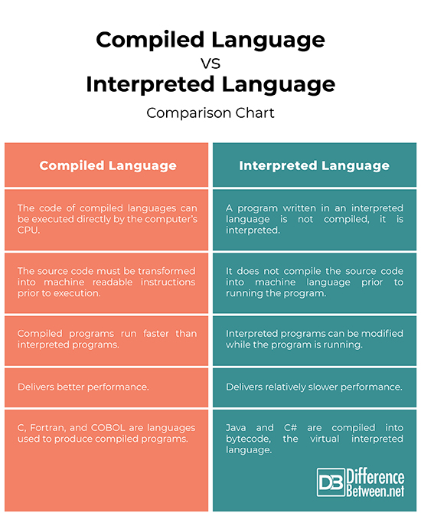

Slide 37
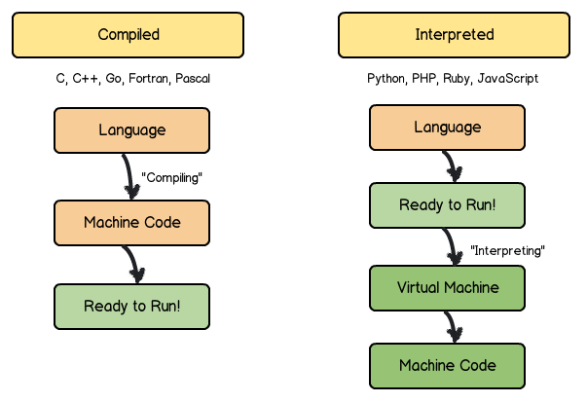
Compiled vs interpreted simplified

Slide 38
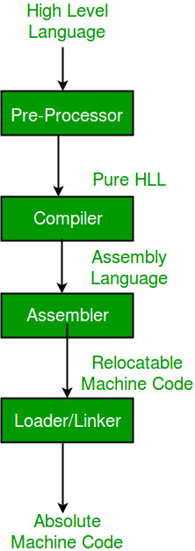
Compile process

Slide 39
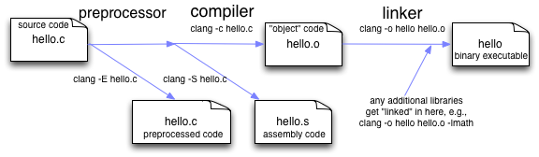
Compiling C in practice

Slide 40
10 minute break!

Slide 41

Software snafus
What can go wrong if we don’t get software right?
Program crashes
System stability compromised
Exploitation
Network breach
Theft of IP/customer data
Loss of reputation
Risk of injury?

Slide 42

Notes:
The 2003 Northeast blackout was caused by an undiscovered race condition in General Electric Energy's XA/21 monitoring software. Some of you might have lived through this, if you lived in the Oakland University area in 2003. I did, and I still remember that 3 day period of my life.

Slide 43
More & more fails
“Spaghetti” code
Difficult to add new features
Poor documentation/code commenting
“Legacy” code maintenance

Slide 44

Let’s look at some code
https://github.com/hexa-decim8/girltalk/blob/master/girltalk.sh

Slide 45

How a program works

Slide 46
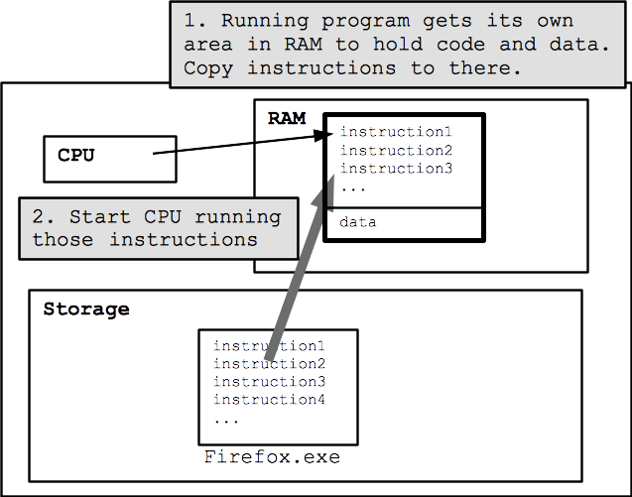
How Firefox works

Slide 47
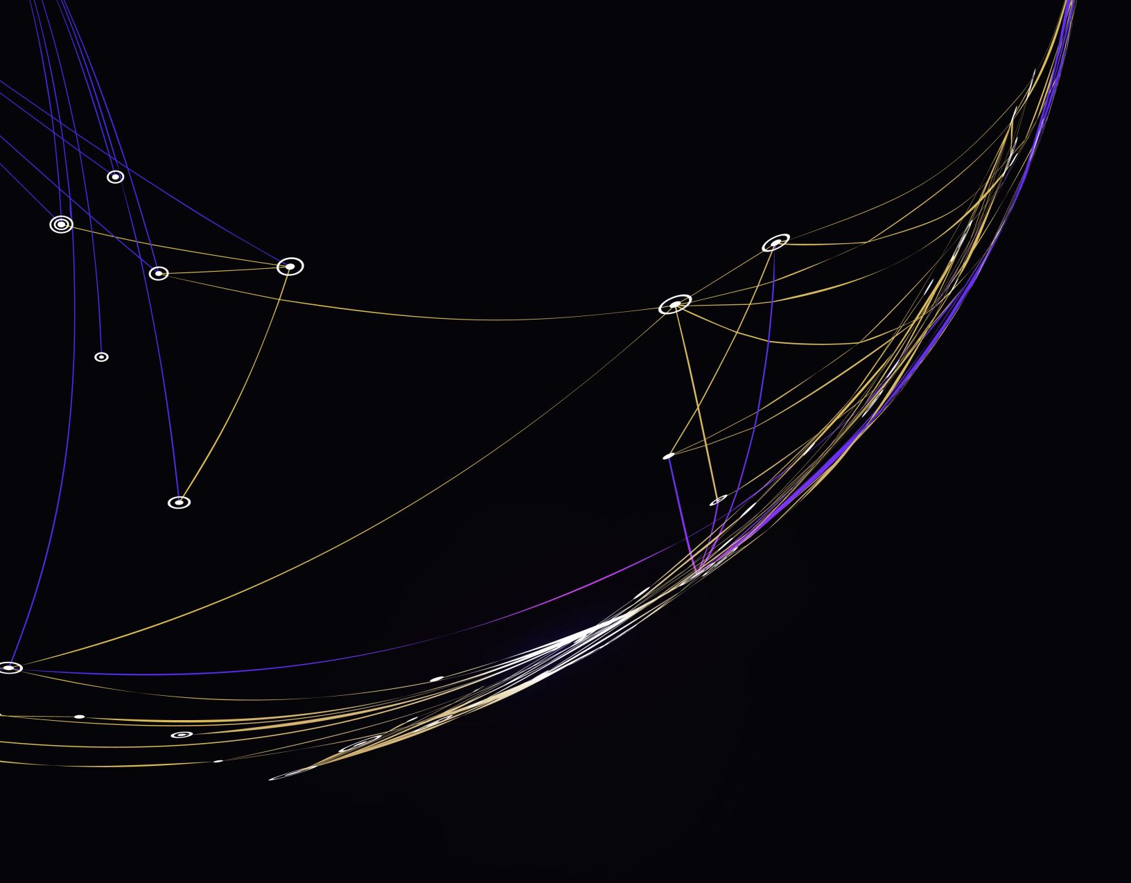
Detailed execution

Slide 48
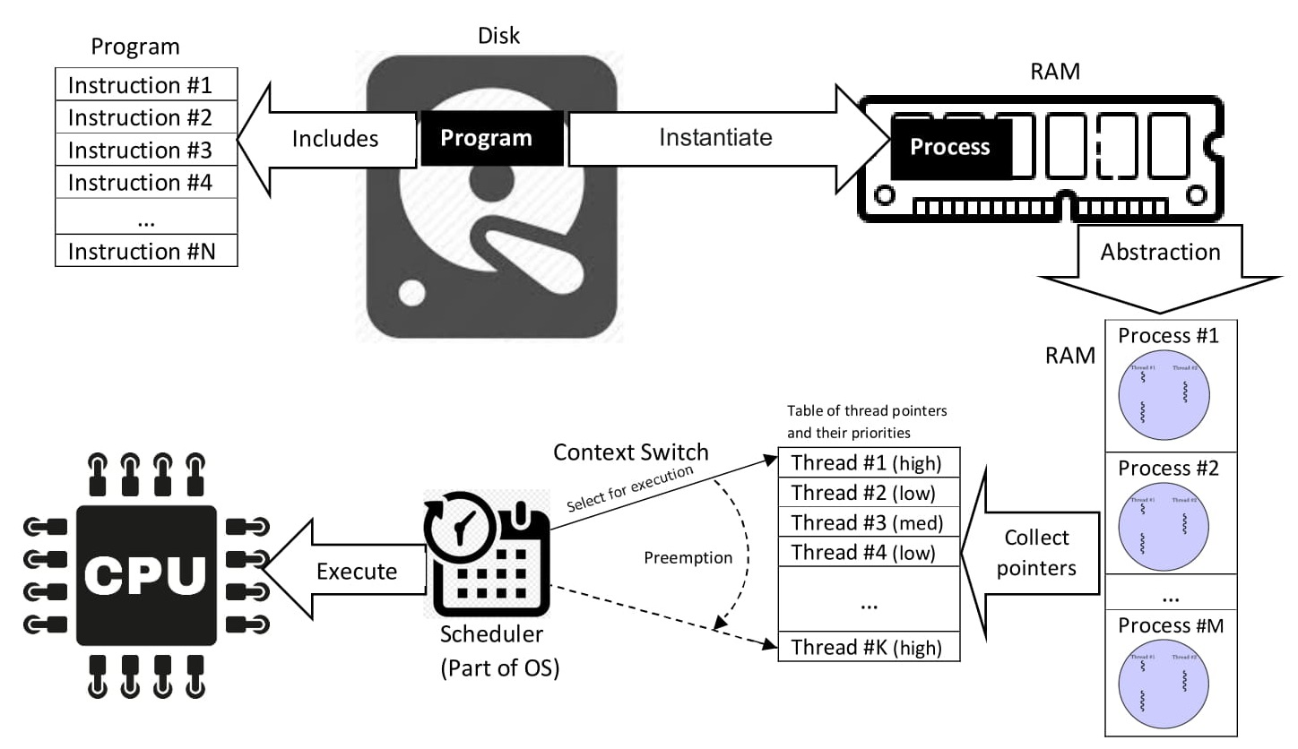

Slide 49

Imagine an outstanding app
Notes:
Everyone nowadays has a smart phone (hardware) and these smart phones have an astounding amount of sensors and wizzbang features on them that apps can use. But as I’m sure we’ve all noticed, not every app is actually all that great. So what I want us all to do for a minute is think about the best app you’ve ever used. Let’s talk about some things that made this app so great to you.

Slide 50
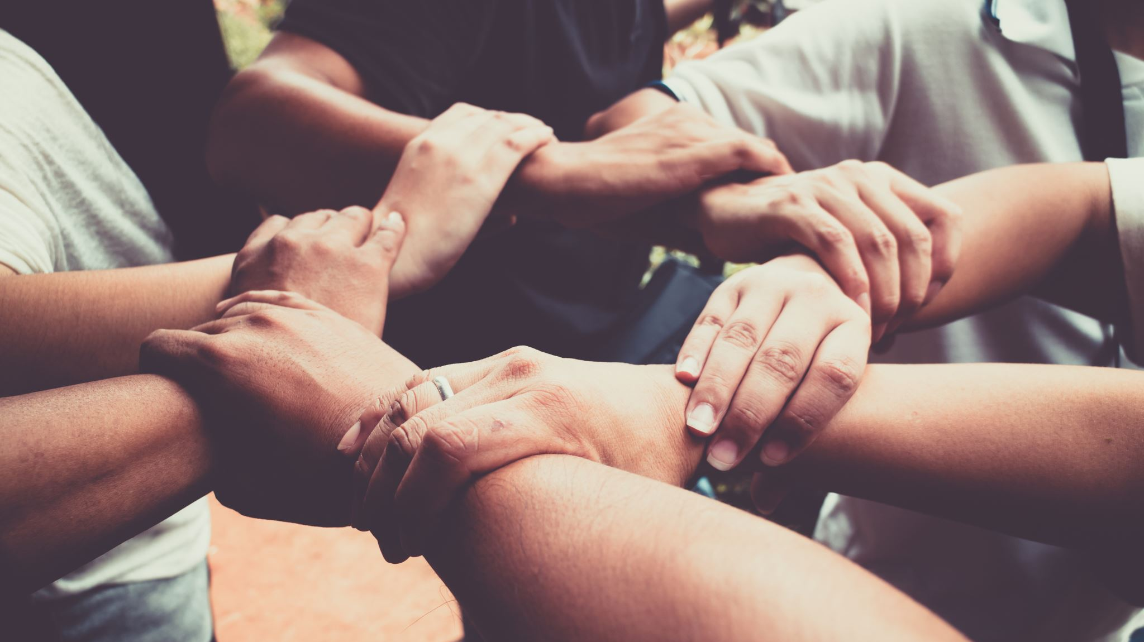
Tying It All together
Hardware is becoming much more diverse these days
Hardware can go places it didn’t used to be able to
Software follows hardware
Making good software is complicated!
Managing these projects is complicated
Notes:
Today we’ve talked about a variety of topics that are important to understand for the sake of software development. So let’s tie these concepts together in this class.

Slide 51

Questions?

Slide 52
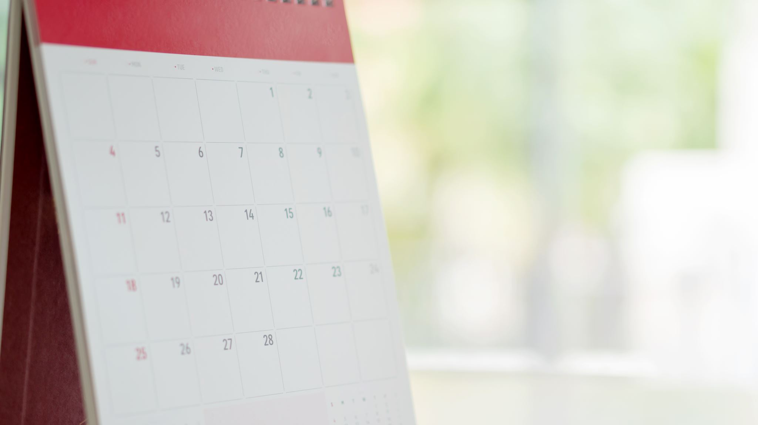
Day 1 review

Slide 53
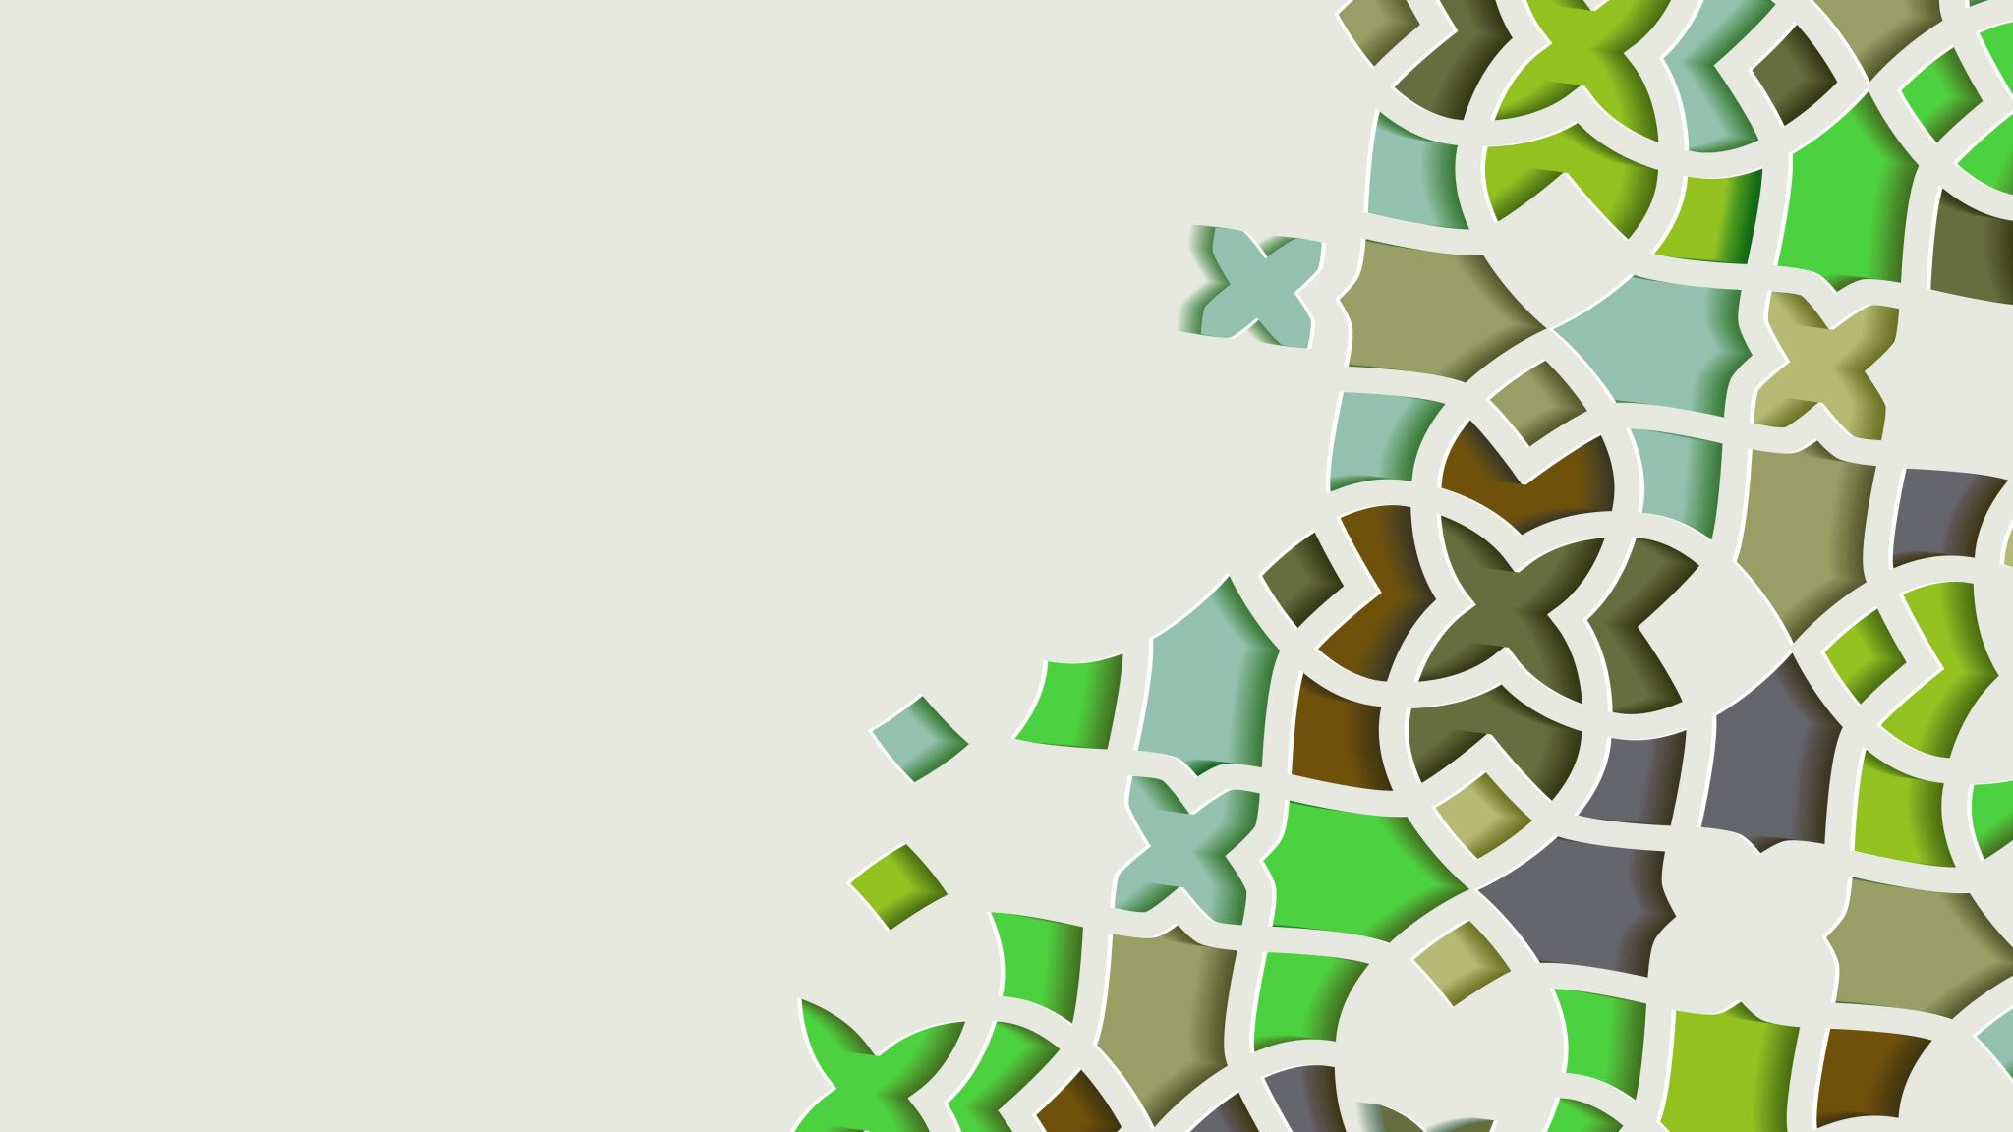
Day 2 preview

Slide 54
Contact info
ecrose@oakland.edu

